Slide 1
Mini Project on Air Pollution Monitoring System

Slide 2
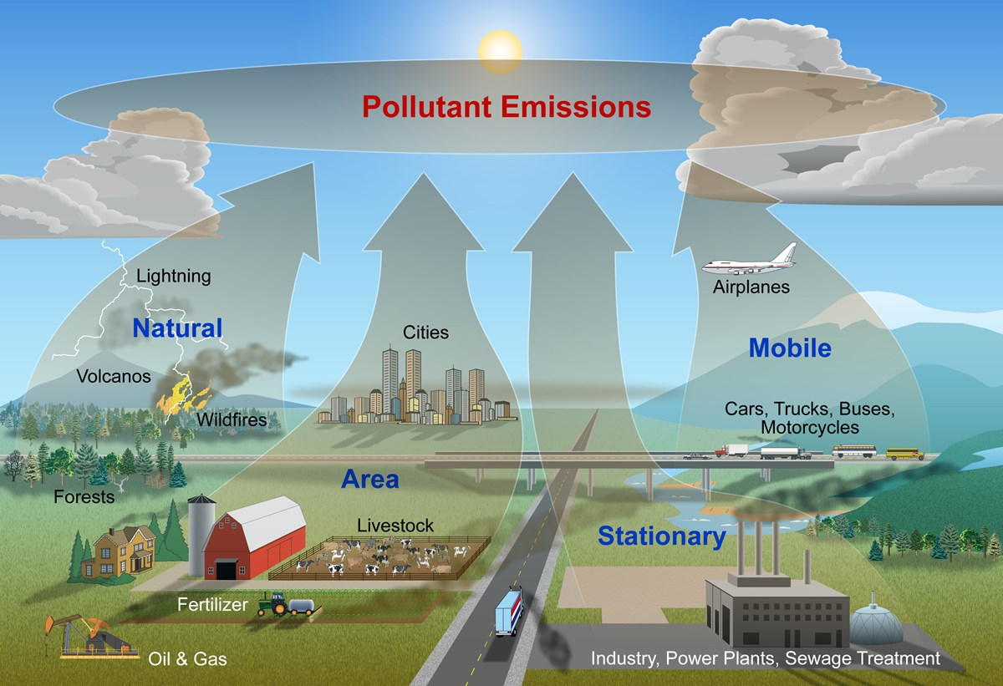
Air pollution
Air pollution occurs when harmful or excessive quantities of substances are introduced into Earth's atmosphere.
Causes of Air pollution
Sources of air pollution are
Burning of fossil fuels like, coal, petroleum, etc.
Agriculture activities,
Mining,
Industrial activities, etc.

Slide 3
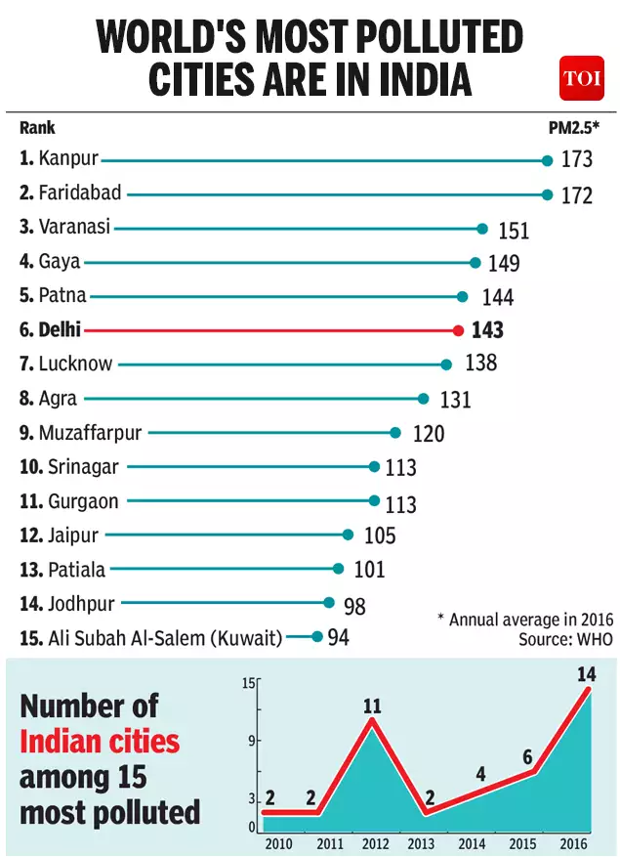
Air pollution in India
Air pollution in India is a serious health issue.
Of the most polluted cities in the world, 21 out of 30 were in India in 2019. ...
The 51% of pollution is caused by the industrial pollution
27% by vehicles, 17% by crop burning and 5% by Diwali fireworks.

Slide 4
Steps in monitoring air pollution levels
Measuring the environmental parameters of the environment. They are:
Smoke level
Atmospheric pressure
Humidity
Temperature
Carbon components
Wind
Adding an alarm system to notify about emergency situations.
Automation using IOT devices to reduce human dependability.
Simulating network on packet Tracer

Slide 5
Sensors Used:
Smoke Detector – To detect the level of smoke present
Atmospheric pressure monitor – To monitor the values of atmospheric values
Humiture sensor - To detect combination humidity and temperature
Temperature sensor – To detect temperature
Wind detector sensor – To detect the wind speed
Carbon-Dioxide sensor - To keep a track of Carbon Dioxide in environment
Carbon-Monoxide sensor - To keep a track of Carbon Monoxide in environment
Siren – To make an alarm system for emergencies

Slide 6
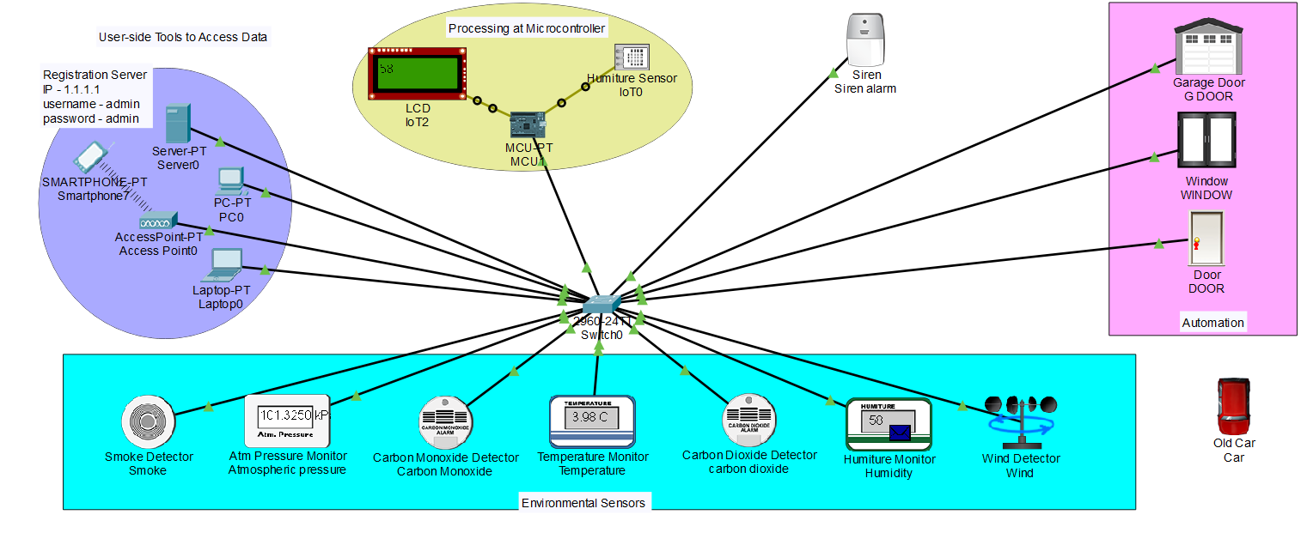
Architecture Diagram:

Slide 7
Protocols Used:
HTTP protocol is for transferring data from Server to Client and used for displaying data to the user using web browser services.
ARP protocol is being used for routing data from sensor , Microcontroller to the switch and the server.
All the connections and allocation of IP addresses are made static in nature.

Slide 8
Conclusion:
Conclusion:
The system will monitor the air of environment using IOT Technology to improve quality of air.
This system also proposes an alarm system which will notify the concerned authorities depending upon the level of smoke and carbon dioxide in the air present.
This automated system will automatically open the doors and windows of the facility/house if the smoke arises upon a certain threshold without the need of any human intervention.
This system aims to bring the air pollution under control by monitoring the air pollution 24 / 7 and taking necessary steps.

